Slide 1
Agallamh le Louise Cantillon
Spin SW

Slide 2
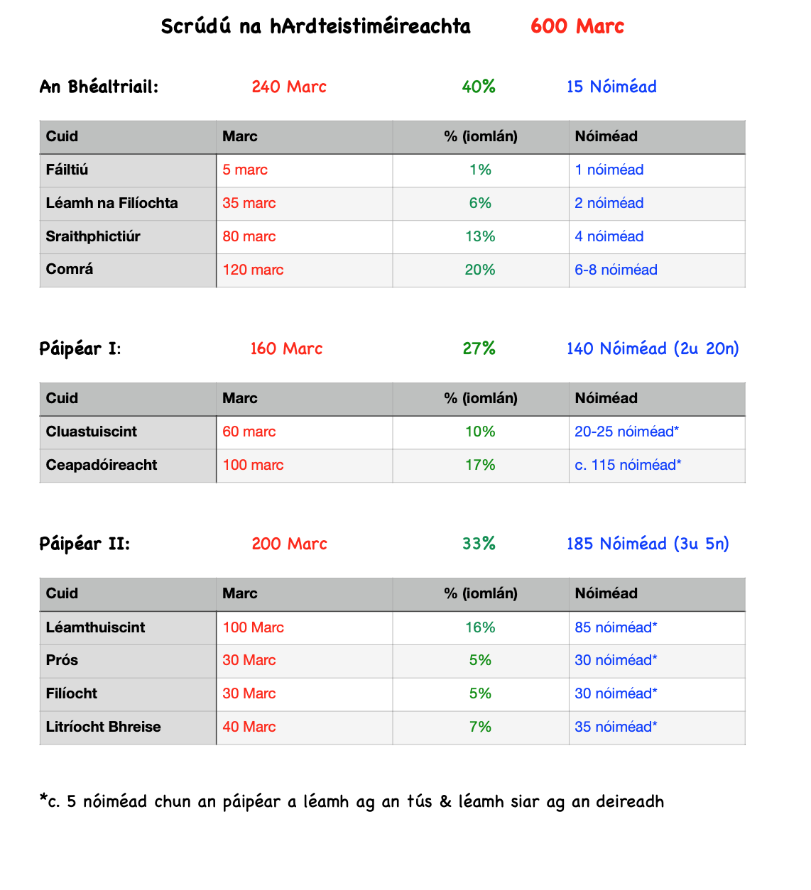

Slide 3
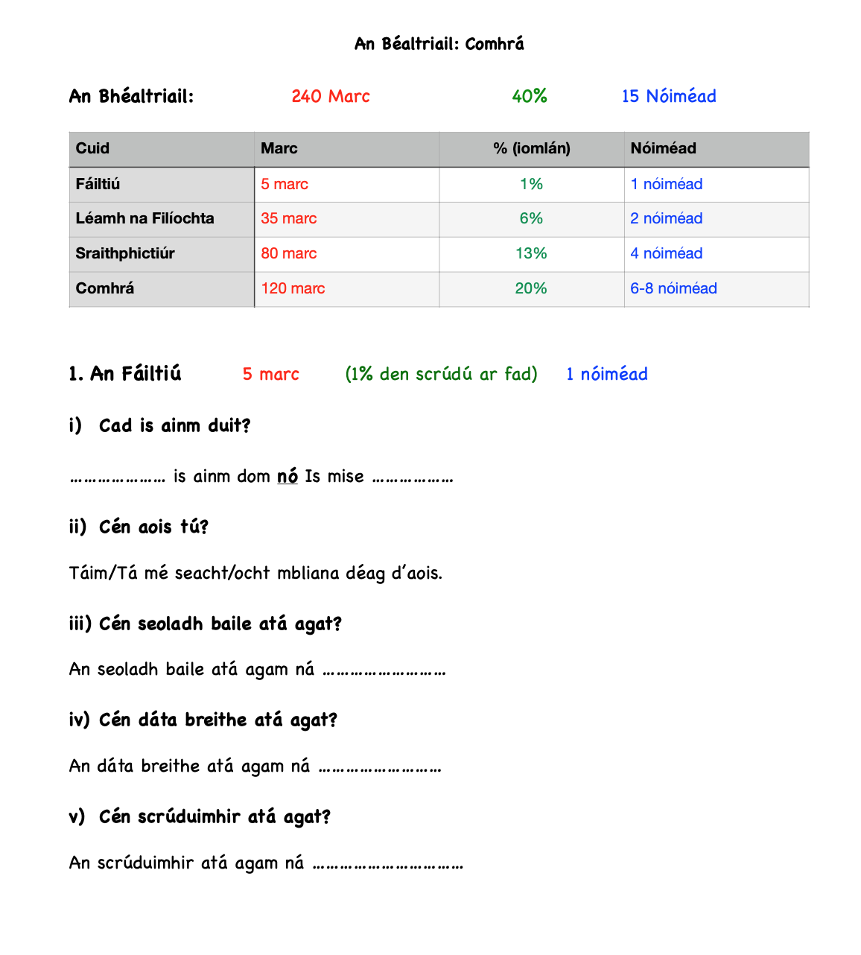

Slide 4
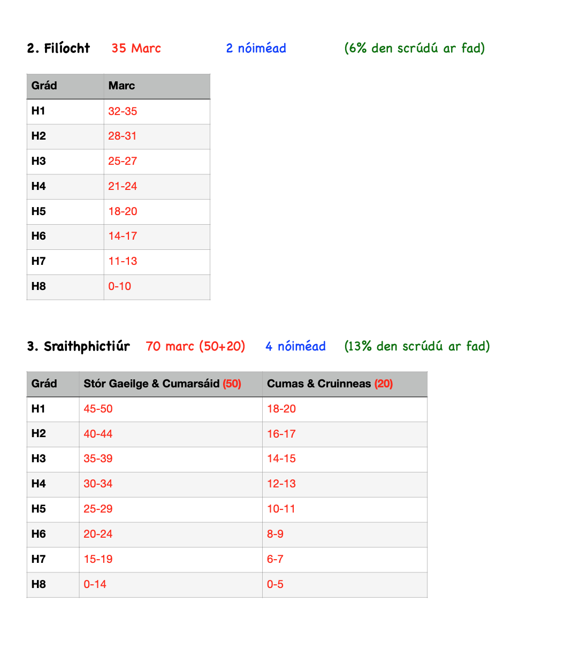
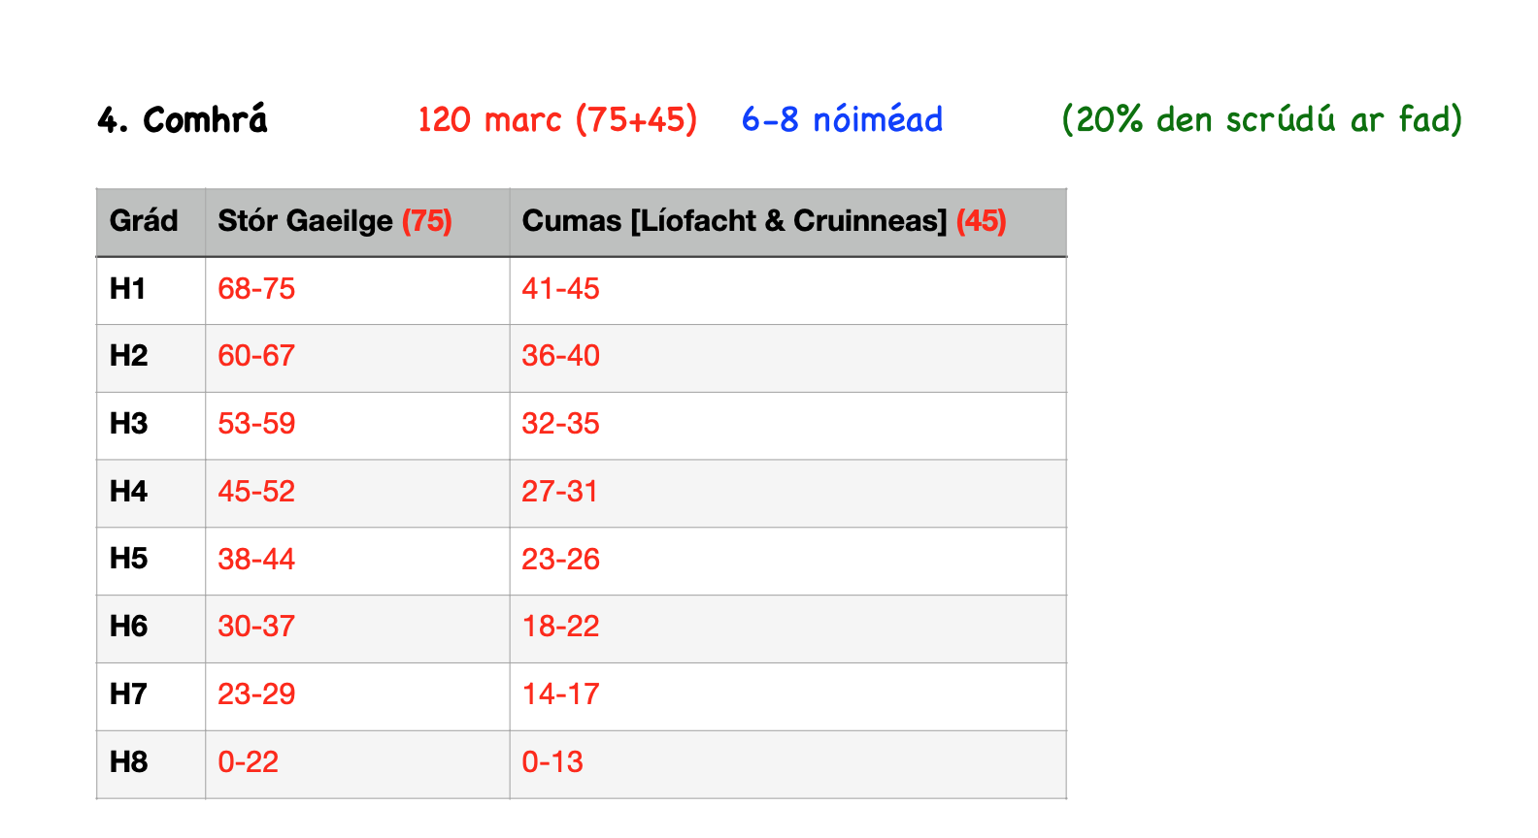

Slide 5
Gaeilge na hArdteiste
Top 10 Tips
1. In the cluastuiscint (aural), focus on the questions/words you do know, not the ones you don’t!
2. Plan your essay. Jot down a few nathana/vocab that you know. You have plenty of time! Up to c. 115 minutes!
3. Go with the essay title you understand best.
4. 80% of the essay marka go for your Gaeilge. It’s worth it to be as accurate as you can be!
5. In the Léamhthuiscint (reading comprehansion) read the questions first.

Slide 6
6. In the léamhthuiscint (reading comprehension). Underline what you think the key words are in the question. Look for them in the text. Most of the time, your answer will be located right there.
7. In your prós and filíocht (prose & poetry) and your prós-théacs. Underline the key words in the question. Recycle those key words in your answer. That will make you stick to the point.
8. In the Béaltriail (oral) you can bring in your poetry book with you and read off it. If you have practiced it, with notes to guide you, there is no reason why you can’t achieve 30-35 marks for that part.
9. In the Béaltriail (oral), when you are handed your sraith-phictiúr, you can take a little while to prepare it to yourself. Take that time!
10. In the comhrá-part of the béaltriail, have plenty of stuff prepared for the old reliables: Mé féin, Mo Teaghlach, Mo Cheantar, Mo Scoil, Caitheamh Aimsire. If you have enough stuff, that should fill in most of the 6-8 minutes!

Slide 7
More info & help?
Contact: KES Educational Services, 83 O’Connell Street, Limerick 061 444989 or info@kes.ie
@Ogie_O_C
ogierinn

